Slide 1
Cross-Platform Mobile Applications Development
B.Sc. Web Technologies & Programming
Department of Computer Science & Applied Physics

Slide 2
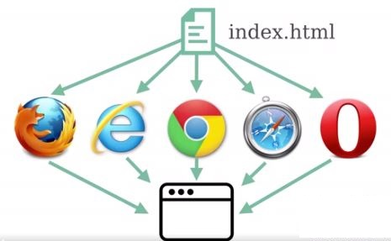
HTML
Web pages are written in HTML
HTML files have the extension .html
Browser understands HTML and displays the page

Slide 3
HTML
HTML uses tags
Tags organise the document
Tags tell the browser a little bit about how to display the Tag’s content*
<html> <head> <body> <h1> <a> <img>
* CSS is used to “beautify” the HTML page

Slide 4
HTML – Tag Structure
Tags usually come in pairs
Opening Tag
Opening angle bracket <
Tag name
Attributes (optional)
Closing angle bracket >
<p>
Closing Tag
Opening angle bracket <
Forward Slash /
Tag name
Closing angle bracket >
</p>

Slide 5
HTML – Elements
A HTML element represents some structure of data and consists of
Opening Tag
Content
Closing Tag
<p>Welcome to GMIT</p>

Slide 6
HTML – Attributes
Attributes provide additional information about HTML elements
<p id="para1">This is the first paragraph</p>
The id attribute is an identifier for the element
<p id="para2" hidden="hidden">This paragraph is hidden</p>
The paragraph element will be hidden

Slide 7
HTML Elements
There are numerous HTML elements described at:
http://www.w3.org/TR/html-markup/elements.html

Slide 8
HTML – Some Common Elements
<html> Defines the entire HTML document
<head> General information e.g. web page title
<body> Defines the content of a web page
<h1> Heading Level
<p> Paragraph
<a> Hypertext Link
<a href=http://www.GMIT.ie>GMIT</a>

Slide 9
HTML – Some Common Elements
<img> Defines an image
<img src="smiley.jpg" alt="Smiley face" height="42" width="42">
<ul> Unordered List (Bullets)
<ol> Ordered List (Numbers)
<li> List Element
<div> Used to separate sections of HTML

Slide 10
HTML – Nested Elements
<body>
<p>This is the first paragraph
<ul>
<li>Item 1</li>
<li>Item 2</li>
<li>Item 3</li>
</ul>
</p>
</body>

Slide 11
HTML – Nested Elements
How would you write HTML code so that when a user clicks on a picture he or she is brought to a website?
What Elements are needed?
How would they be nested?

Slide 12
HTML More Attributes
Style
color
text-align
font-family
<h1 style="color:red; text-align:center; font-family:Arial">Heading</h1>
Any problems with this?

Slide 13
HTML
Styling and Layout are mixed together
Maintainability reduced e.g. change all h1 tags to blue
CSS should be in a separate file to HTML

Slide 14
Cascasing Style Sheets - CSS
CSS is a stylesheet language that describes how HTML elements are to be displayed
HTML describes content
CSS describes presentation
Link CSS file to HTML in the <head>
<link rel="stylesheet" type="text/css" href="mystyle.css">

Slide 15
CSS – Rule Sets
Point to HTML element(s) to style
Selector { property : value; }
Examples
h1 { color : blue; }
p { font-family : serif; }
div { text-align : left; background-color : red }

Slide 16
CSS Selectors
.class
.myclass - Selects all elements with the class “myclass”
#id
#myid – Selects the element with the id “myid”

Slide 17
CSS Selectors
element
p – Selects all <p> elements
*
Selects all elements
p[id]
Selects all p elements with an attribute named id
Full list of CSS Selectors
http://www.w3.org/TR/css3-selectors/#selectors

Slide 18
HTML and CSS Validation
Validate HTML at https://validator.w3.org/
Validate CSS at https://jigsaw.w3.org/css-validator/

Slide 19
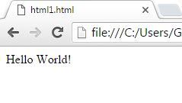
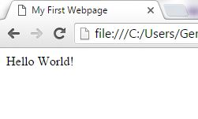
HTML Web Page
<!DOCTYPE HTML>
<html>
Hello World!
</html>
<!DOCTYPE html>
<html>
<head>
<title>
My First Webpage
</title>
</head>
<body>
Hello World!
</body>
</html>

